Slide 1

Data Science

Slide 2

Agenda
Future Skills
Job Opportunities
Job Roles and Average Salary
Data Science Application
Data / Data Growth
Difference AI, ML, DL
Machine Learning Steps

Slide 3

Future Skills
02

Slide 4
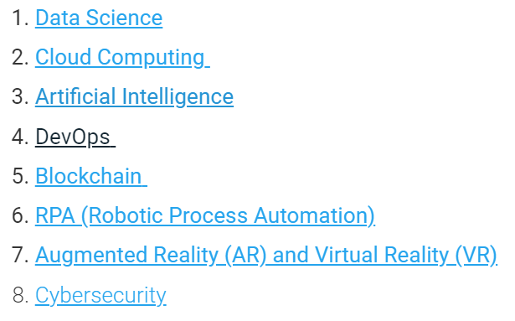
Future Skills and Job Opportunities
https://hrforecast.com/a-guide-to-future-oriented-skills-skills-in-demand-to-watch-in-the-next-five-years/
https://www.naukri.com/learning/articles/trending-tech-skills-to-master/
https://www.freepressjournal.in/business/top-five-tech-skills-in-high-demand-in-2022-to-get-a-well-paid-job
Skills in demand for the next five years
Most In Demand Tech Skills to Master in 2022
Top five tech skills in high demand in 2022 to get a well-paid job
Cloud computing
Cybersecurity.
Artificial intelligence and machine learning.
Big Data analytics.
Cloud Computing specialists
Artificial Intelligence
Mobile application developers
Blockchain technology
User Experience (UX) designers

Slide 5
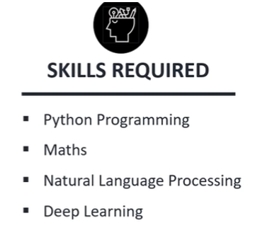


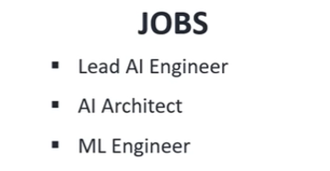
Skills and Job Roles in Data Science

Slide 6
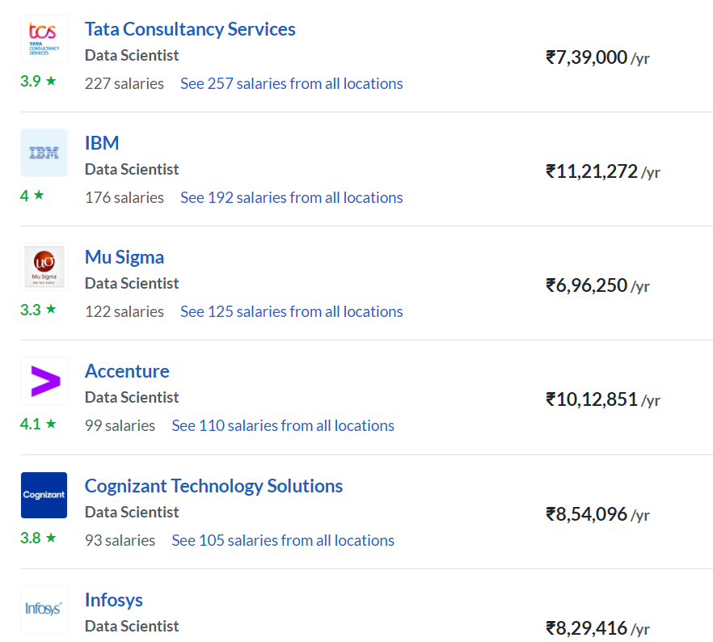
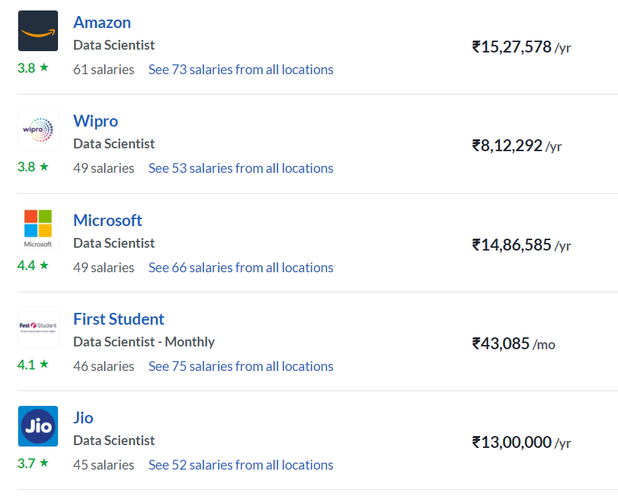
Average Salary
https://www.glassdoor.co.in/Salaries/data-scientist-salary-SRCH_KO0,14.htm

Slide 7
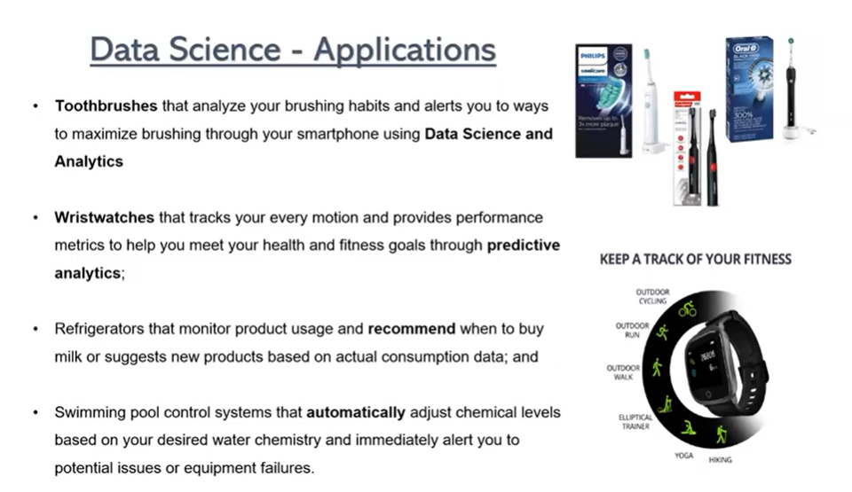
Data Science - Applications
02

Slide 8

Application of ML /DS
Facebook facial recognition

Slide 9

Application of ML /DS
Connected Reality

Slide 10

Application of ML /DS
Virtual reality headsets

Slide 11
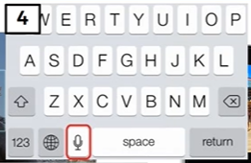
Application of ML /DS
Phone: text to speech to text or voice recognition.

Slide 12
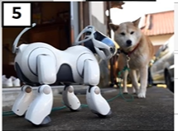
Application of ML /DS
Robot Dogs : Reinforcement Learning.

Slide 13

Application of ML /DS

Slide 14

Application of ML /DS

Slide 15

Application of ML /DS
Health Care Industry

Slide 16

Application of ML /DS
Space Research

Slide 17

Application of ML /DS

Slide 18
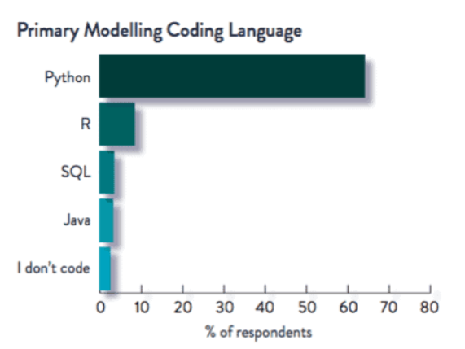
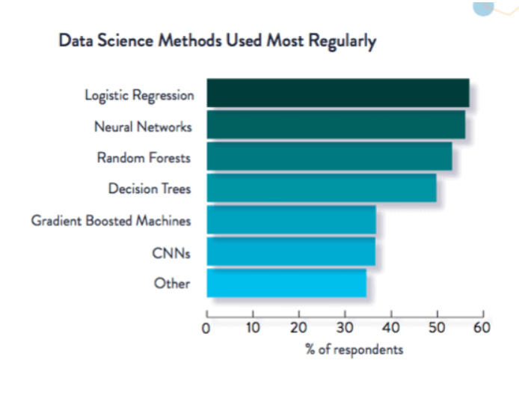
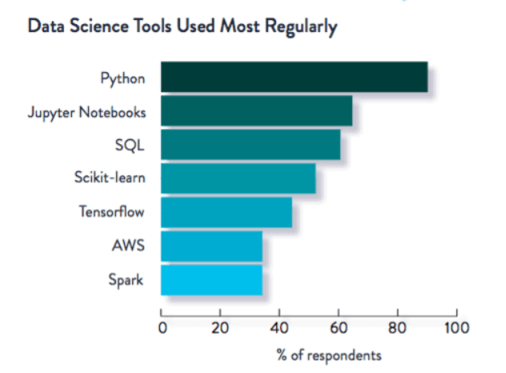
Data Science Skills
02

Slide 19
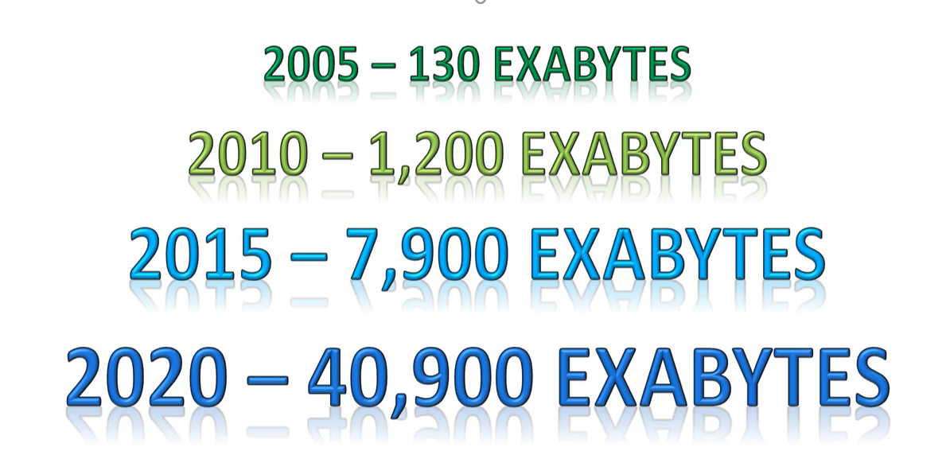
Data Growth
02

Slide 20
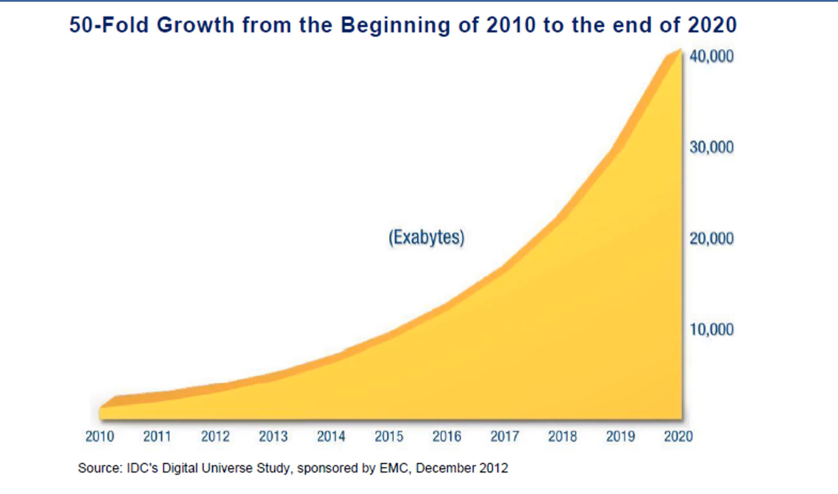
Data Growth
02

Slide 21
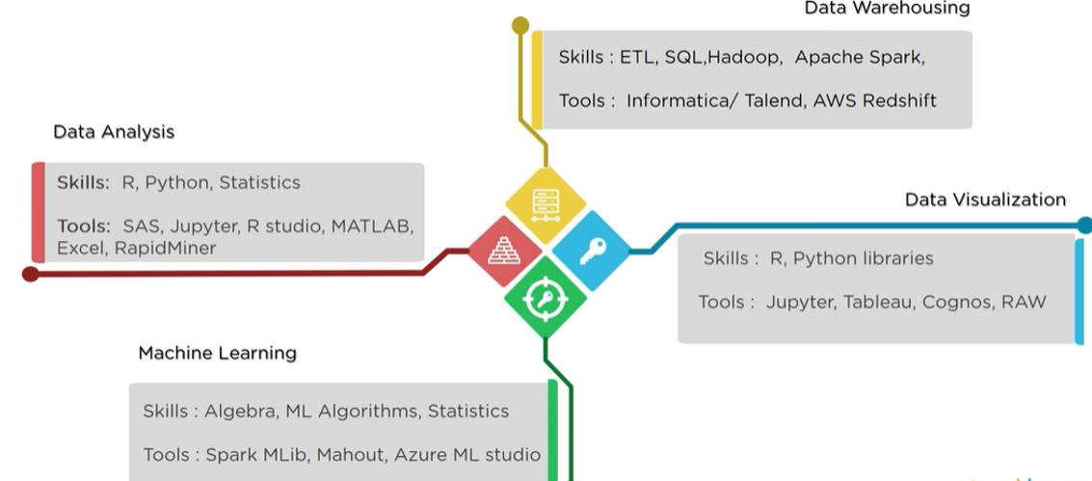
Tools
02

Slide 22

Applications
02

Slide 23
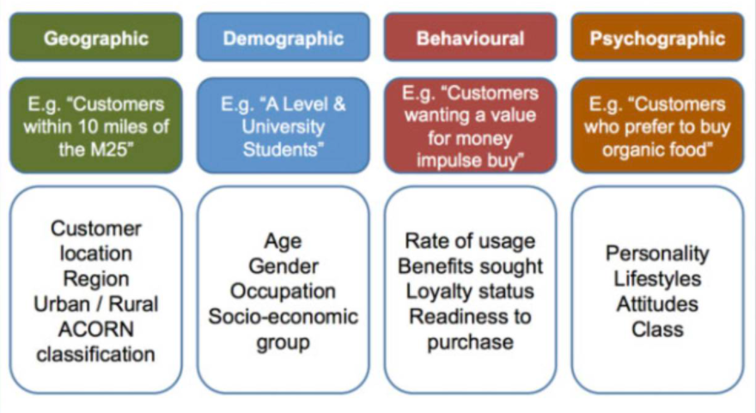
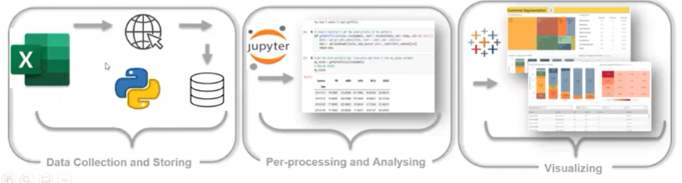
Customer Segmentation
02

Slide 24
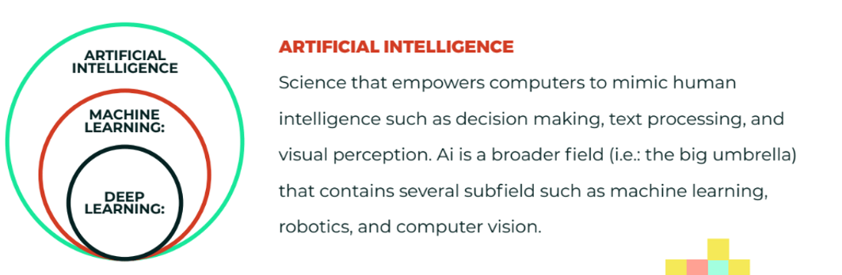
AI ,ML, DL
02

Slide 25
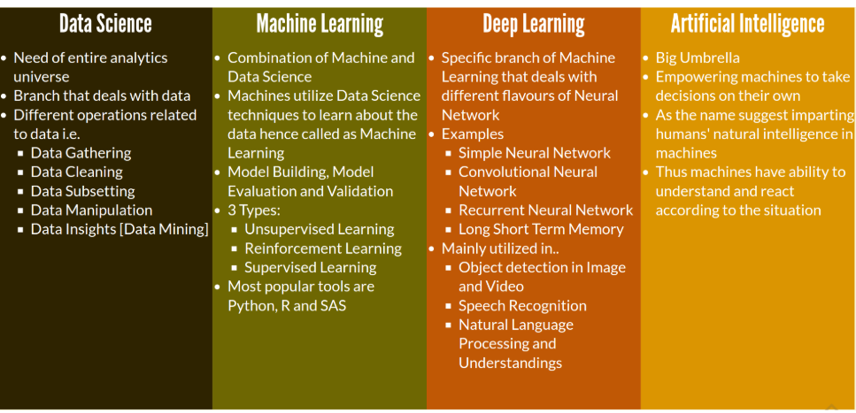
Data Science, AI ,ML, DL
02

Slide 26
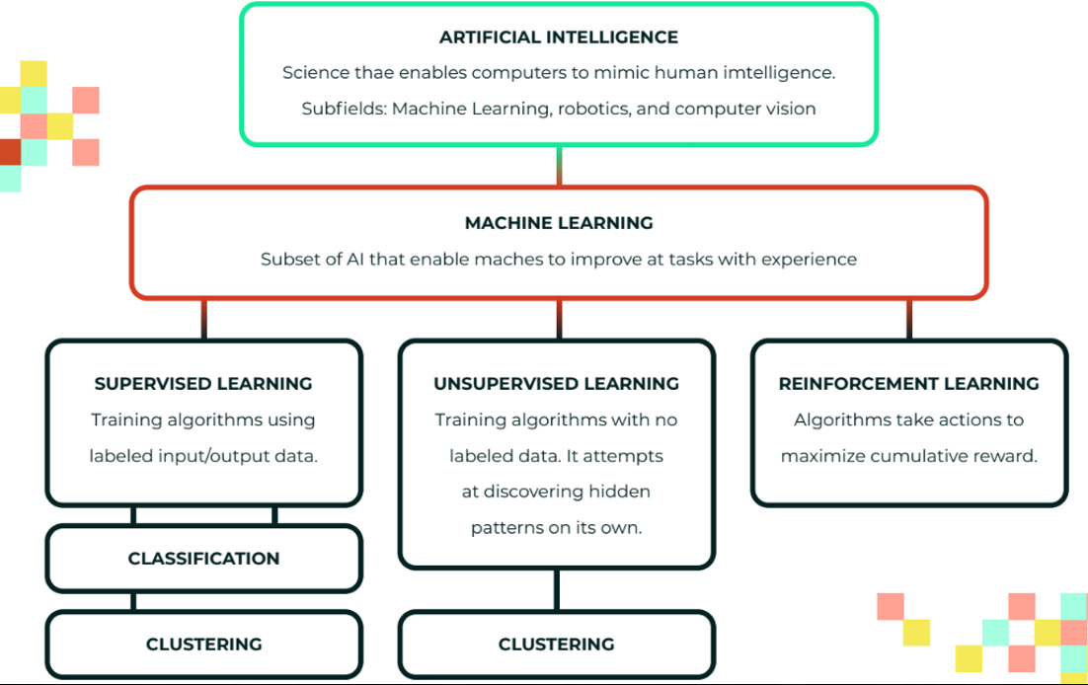

Slide 27
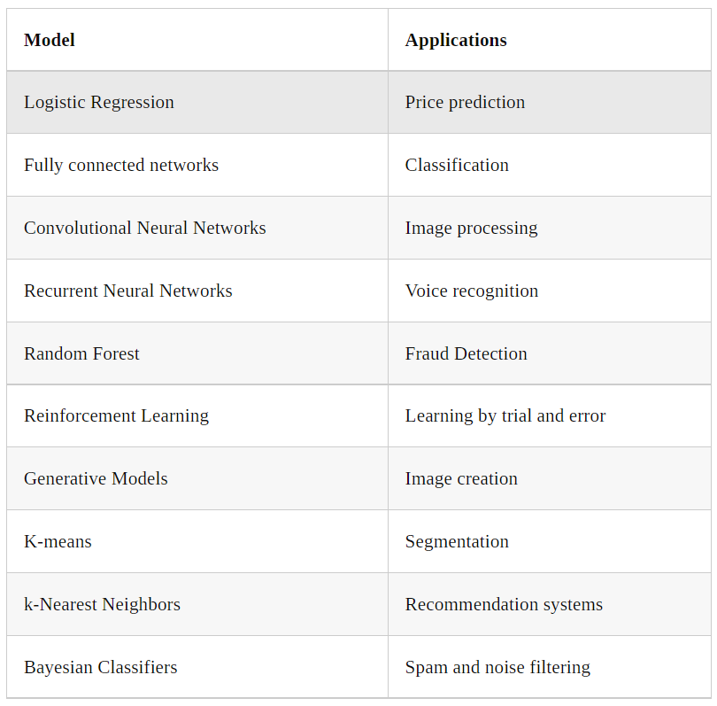
02

Slide 28
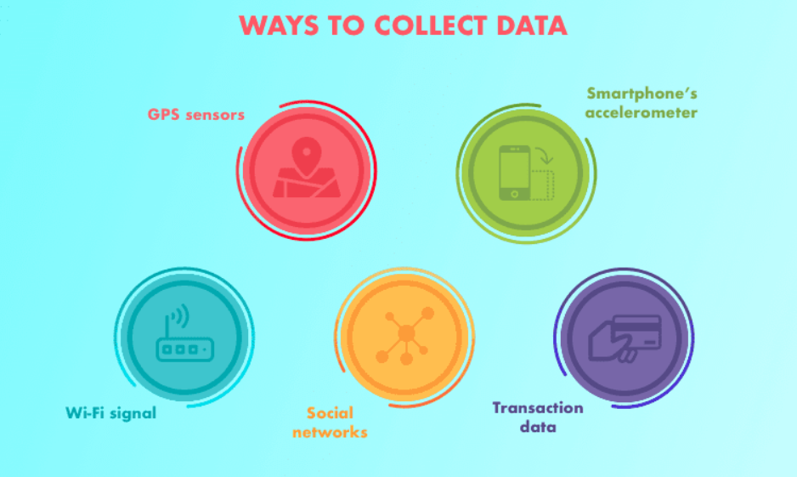
Machine Learning Steps –Data Collection

Slide 29
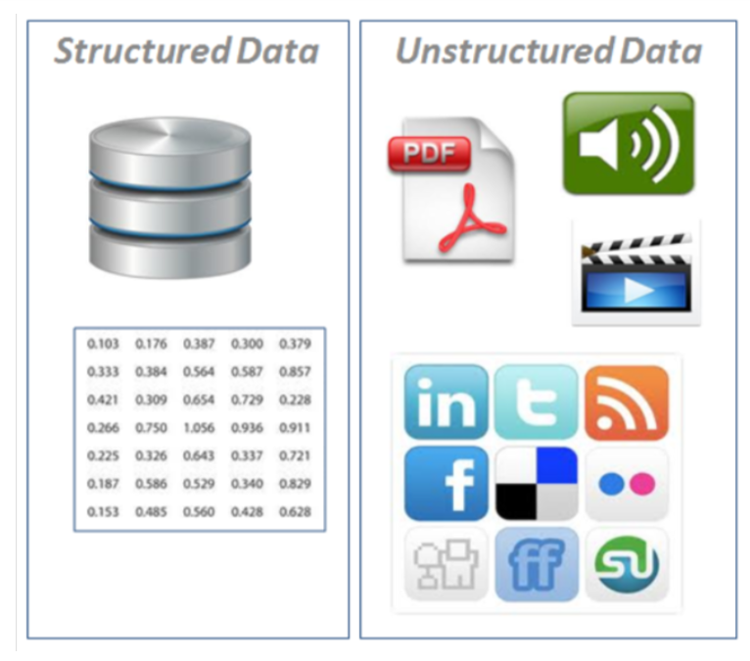
Machine Learning Steps- Types of Data

Slide 30
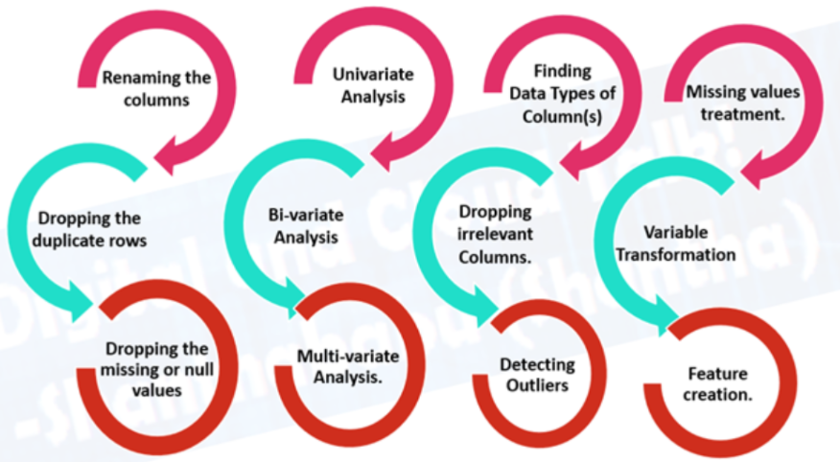
Machine Learning Steps- Data Preparation

Slide 31
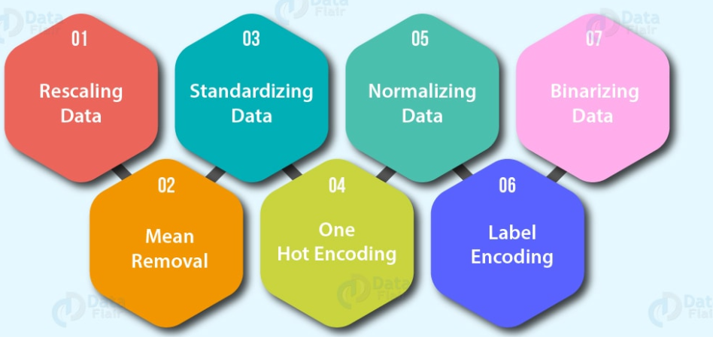
Machine Learning Steps- Data Preprocessing

Slide 32
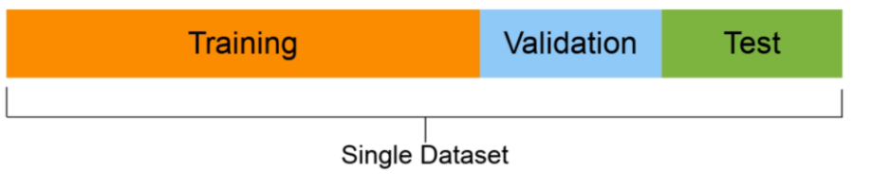
Machine Learning Steps- Data Split

Slide 33
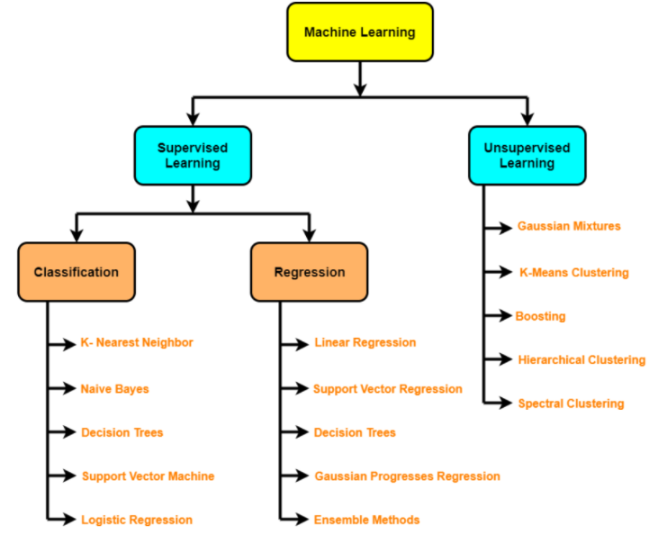
Machine Learning Steps- Create Model

Slide 34
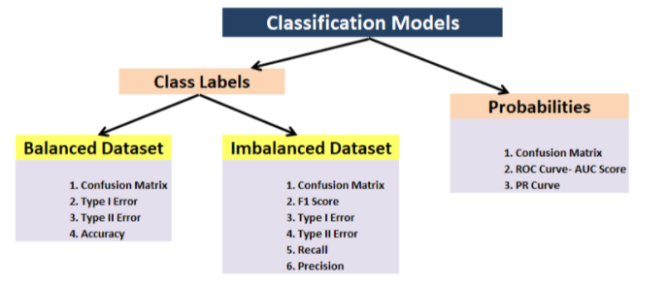
Machine Learning Steps- Analysis – Evaluations

Slide 35

Machine Learning Steps- Deploy the Model

Slide 36
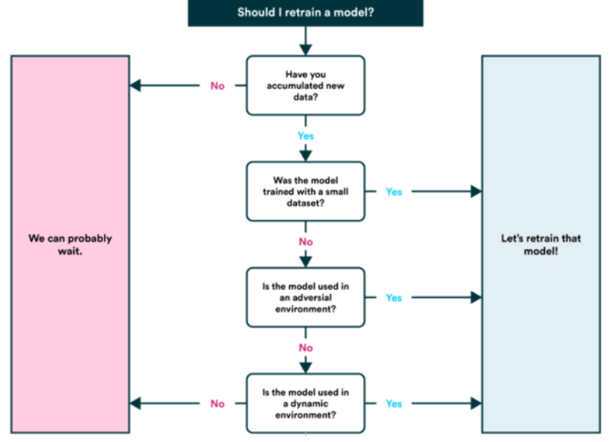
Machine Learning Steps- Retain the Model

Slide 37
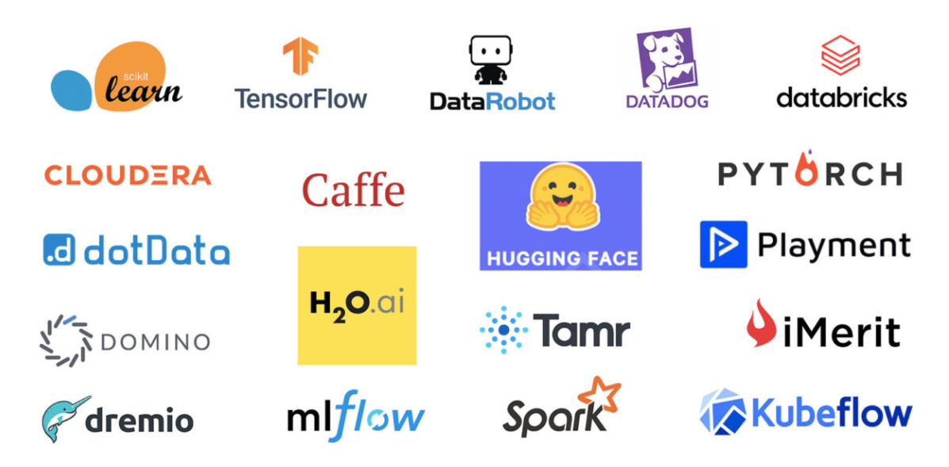
Machine Learning Tools

Slide 39

Introduction to Python
Noble Xavier

Slide 40
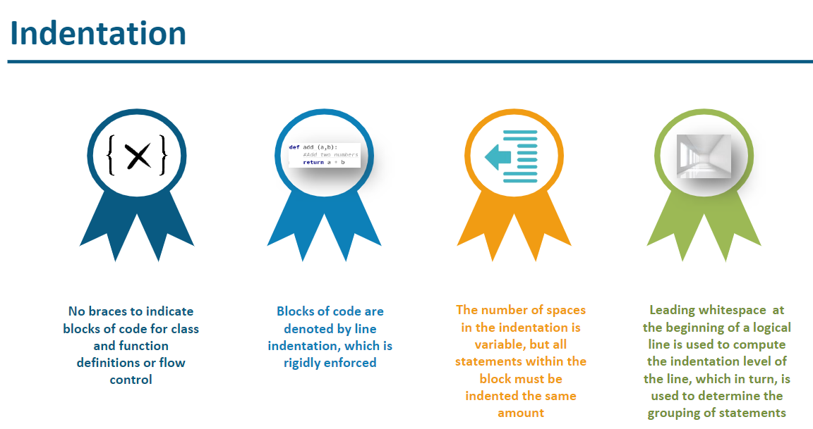

Slide 41
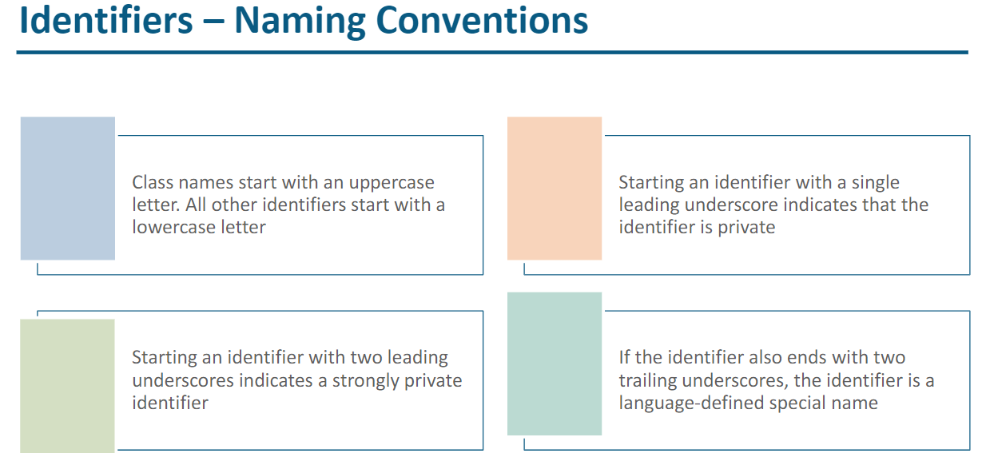

Slide 42
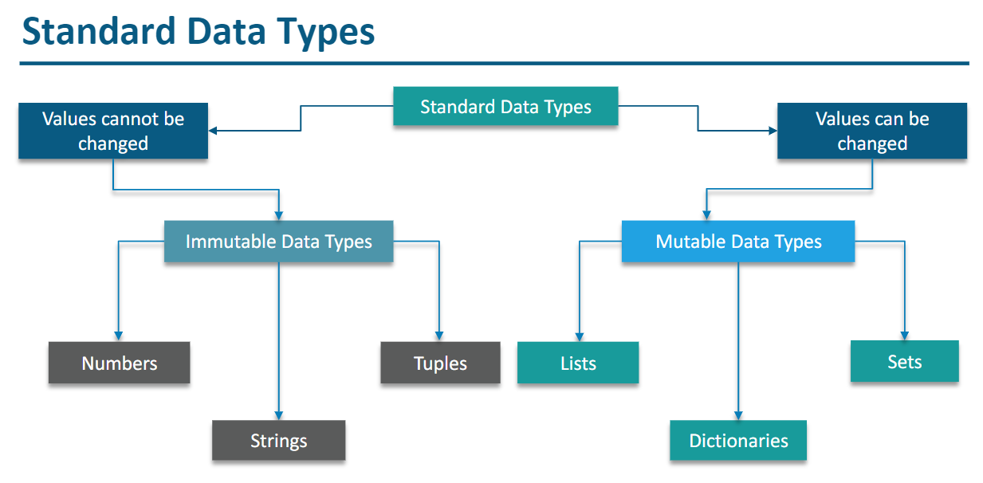

Slide 43
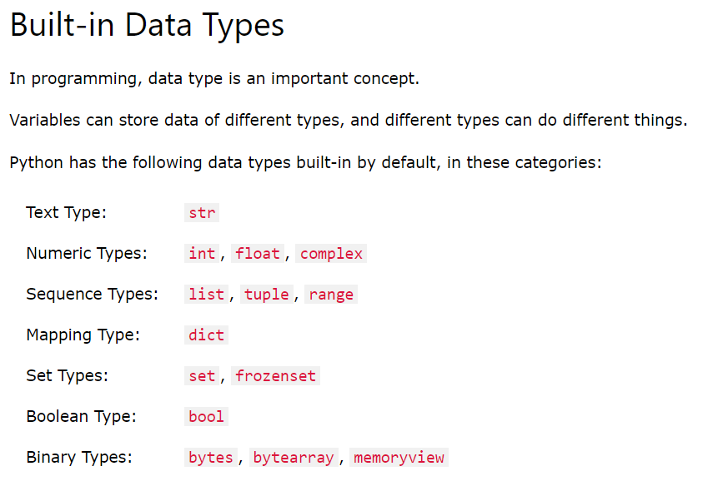

Slide 44
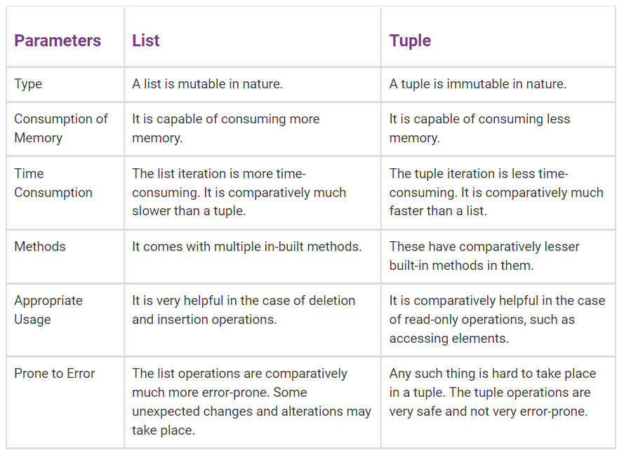
Difference Between List and Tuple in Python

Slide 45
Difference Between List and Tuple in Python
Operations
Although there are many operations similar to both lists and tuples, lists have additional functionalities that are not available with tuples. These are insert and pop operations, and sorting and removing elements in the list.
Size
In Python, tuples are allocated large blocks of memory with lower overhead, since they are immutable; whereas for lists, small memory blocks are allocated. Between the two, tuples have smaller memory. This helps in making tuples faster than lists when there are a large number of elements.

Slide 46
Difference Between List and Tuple in Python
Length
Lengths differ in the two data structures. Tuples have a fixed length, while lists have variable lengths. Thus, the size of created lists can be changed, but that is not the case for tuples.
Debugging
When it comes to debugging, in lists vs tuples, tuples are easier to debug for large projects due to its immutability. So, if there is a smaller project or a lesser amount of data, it is better to use lists. This is because lists can be changed, while tuples cannot, making tuples easier to track.

Slide 47
bytes, bytearray, memoryview
It can store Values from 0 to 255
bytes and bytearray are used for manipulating binary data. The memoryview uses the buffer protocol to access the memory of other binary objects without needing to make a copy.
Bytes objects are immutable sequences of single bytes. We should use them only when working with ASCII compatible data.
The syntax for bytes literals is same as string literals, except that a 'b' prefix is added.
bytearray objects are always created by calling the constructor bytearray(). These are mutable objects.

Slide 48
bytes, bytearray, memoryview
Bytes
It can store Values from 0 to 255
example -1
b1= bytes ([10,20,30,255])
print (b1) # Print Bytes
for i in b1:
print (i)
example -2- Error – since value more than 255
b1= bytes ([10,20,30,300])
print (b1) # Print Bytes

Slide 49
bytes, bytearray, memoryview
Bytes
It is immutable - Item assignment not possible
example -1 – This is not possible since immutable
b1[1] =25

Slide 50
bytes, bytearray, memoryview
Bytearray
It is mutable - Item assignment possible
example -1
b1= bytearray([10,20,30,255])
print (b1)
b1[1]=100 # update first element with 100
for i in b1:
print (i)

Slide 51
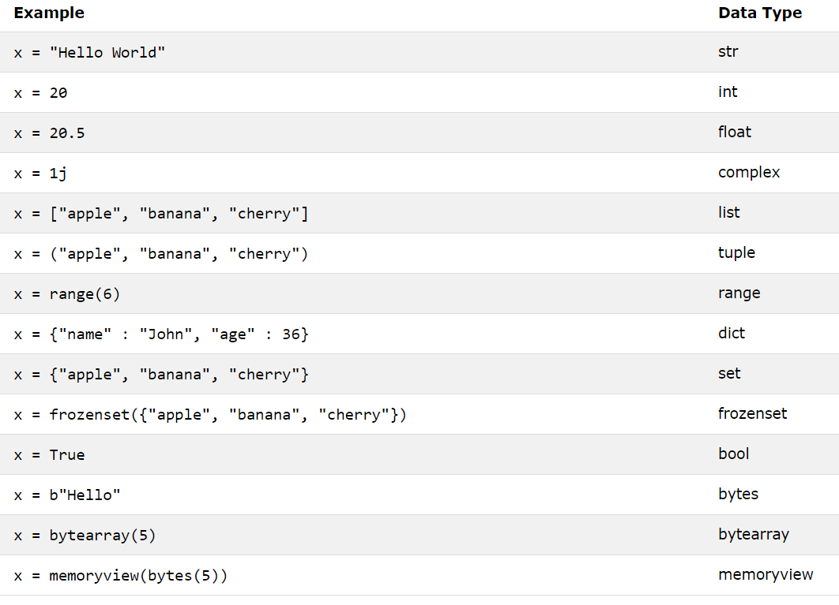

Slide 52
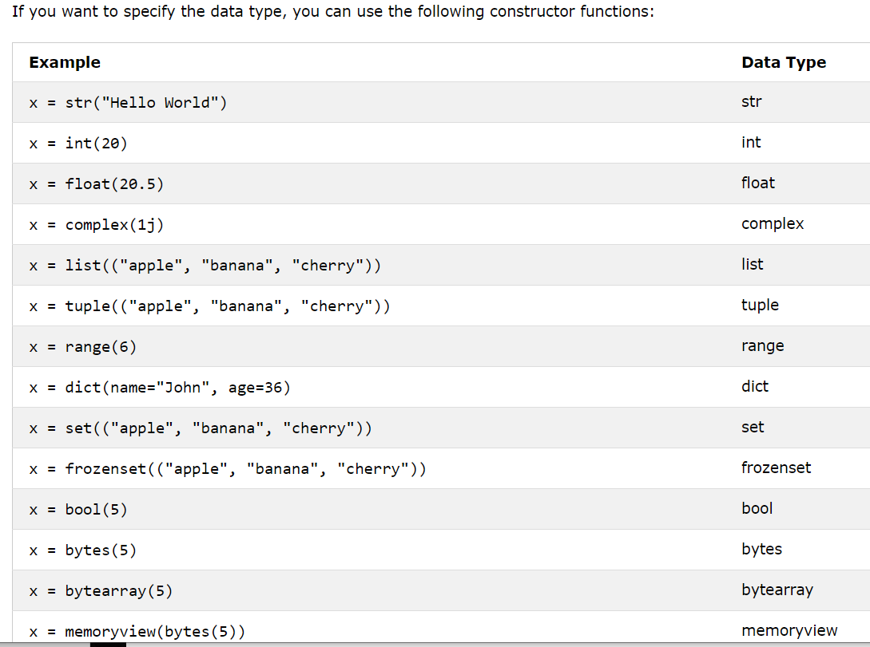

Slide 53
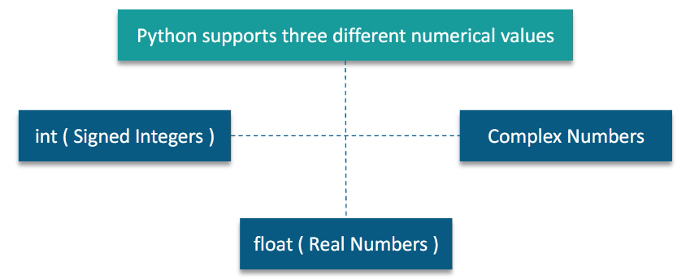

Slide 54
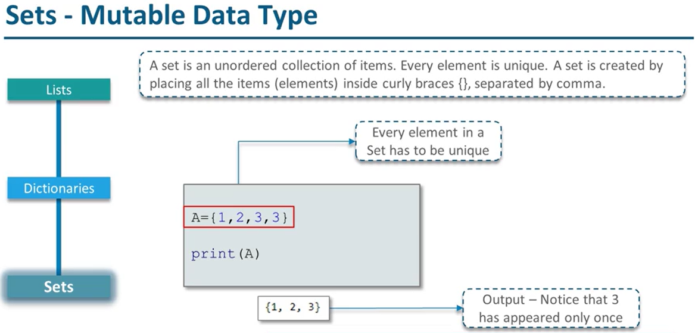

Slide 55
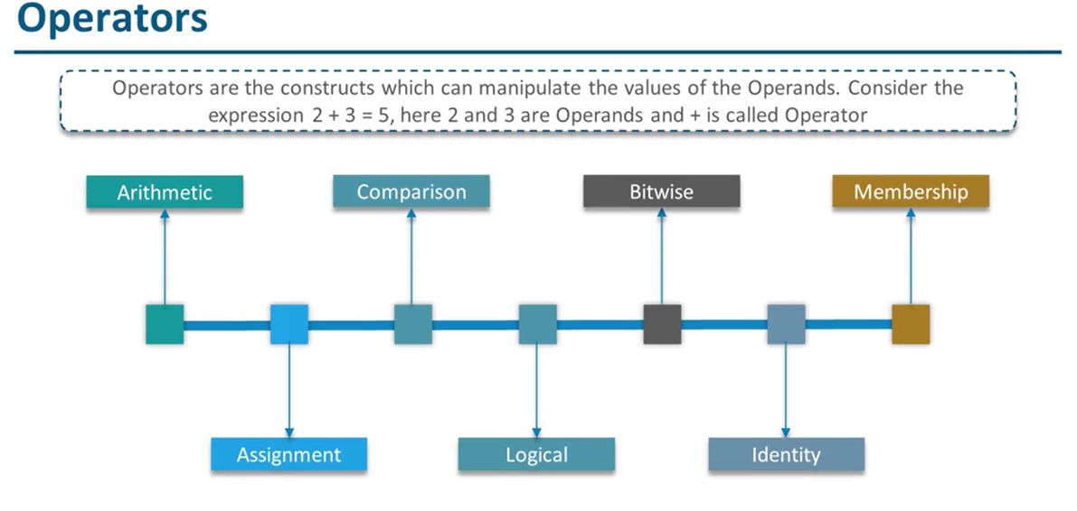

Slide 56
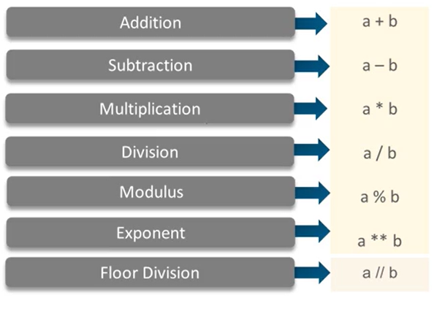
Arithmetic Operator

Slide 57
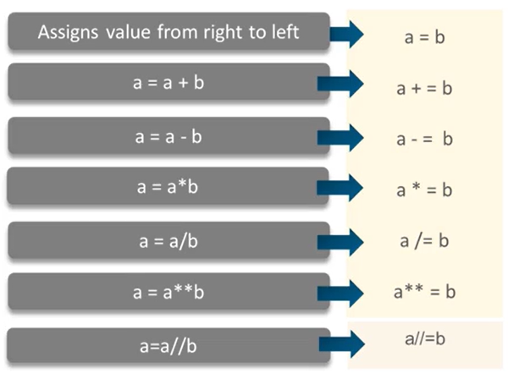
Assignment Operator

Slide 58
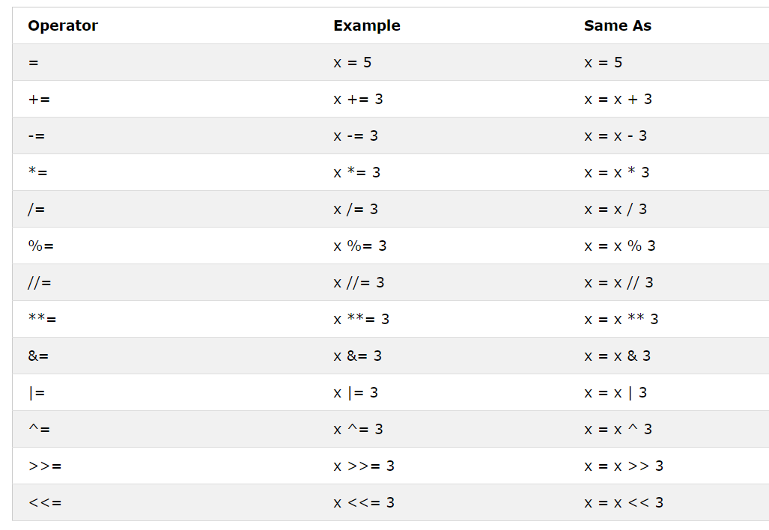

Slide 59
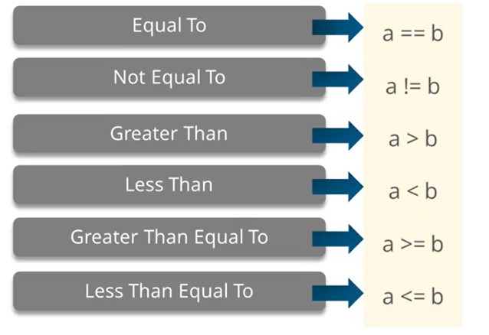
Comparison True / False

Slide 60
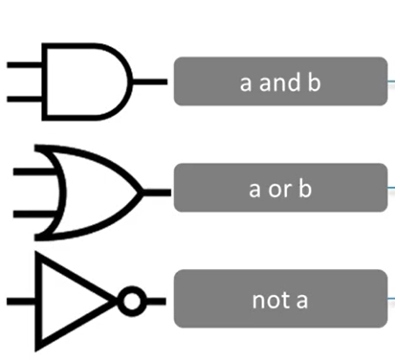
Logical Operator

Slide 61
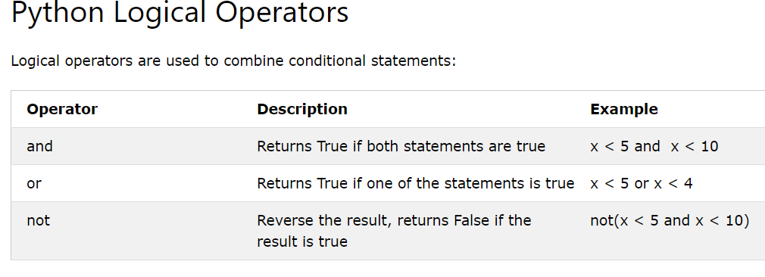

Slide 62
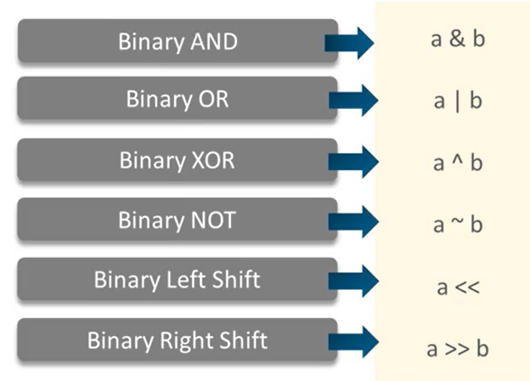
Bitwise -Operator

Slide 63
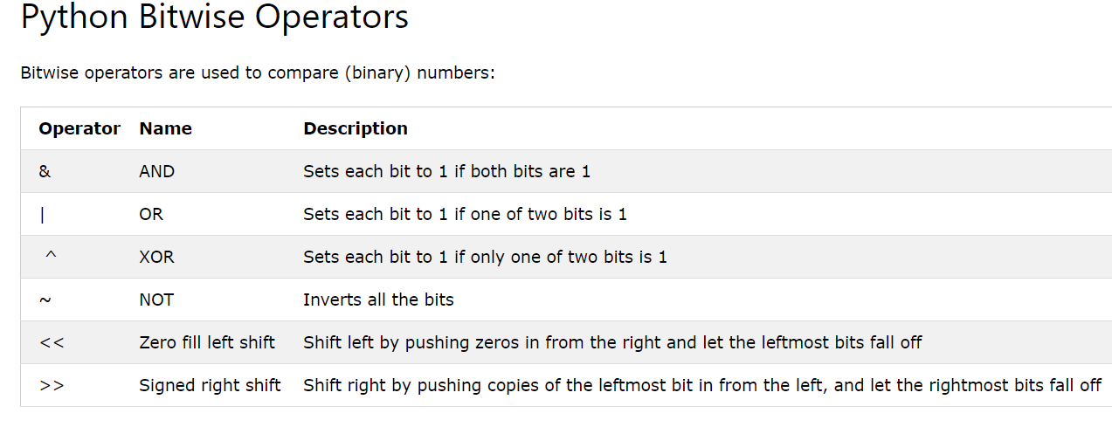

Slide 64
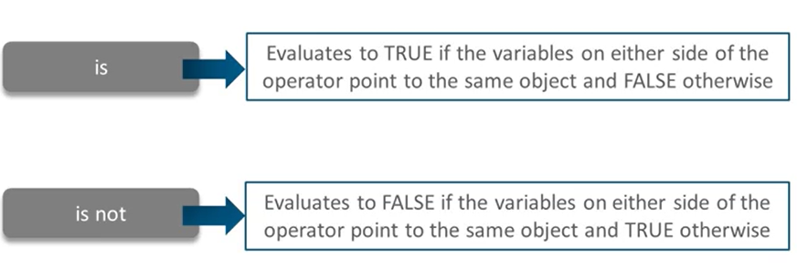
Identity Operator

Slide 65
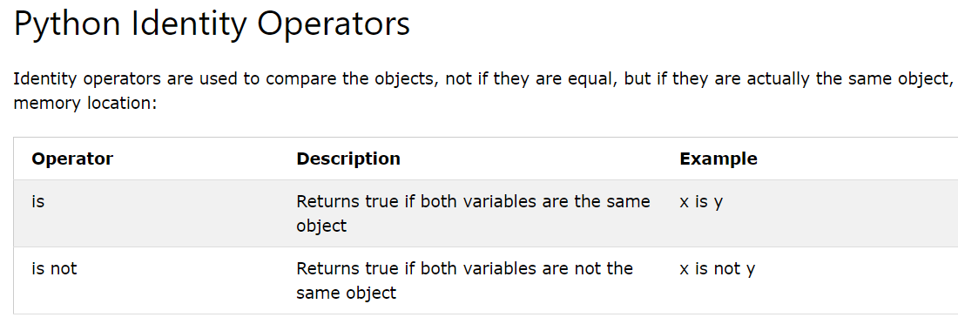

Slide 66
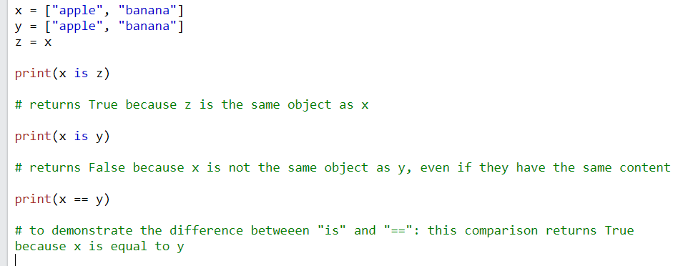
x = ["apple", "banana"]
y = ["apple", "banana"]
z = x
print(x is z)
print(x is y)
print(x == y)

Slide 67


Slide 68

a = 50
b = 50
c= a
print (id(a))
print (id(b))
print (id(c))
print (a is b)
print (c is a)
print (c is b)
a = 500
b = 500
c= a
print (id(a))
print (id(b))
print (id(c))
print (a is b)
print (c is a)
print (c is b)

Slide 69

a = 256
b = 256
print (a is b)
print ( id(a))
print ( id(b))
when their values are outside the range of common integers (ranging from -5 to 256), they’re stored at separate memory addresses.
a = 257
b = 257
print (a is b)
print ( id(a))
print ( id(b))

Slide 70
Append
Copy- Different Location
a = [1, 2, 3]
b = a
print (a)
print (id(a))
print (b)
print (id(b))
print ()
print (a is b)
print ('*****Append****')
print ()
a.append(4)
print (a)
print (id(a))
print (b)
print (id(b))
print (a is b)
a = [1, 2, 3]
b = a.copy()
print (a)
print (id(a))
print (b)
print (id(b))
print ()
print (a is b)
print ('*****Append****')
print ()
a.append(4)
print (a)
print (id(a))
print (b)
print (id(b))
print (a is b)

Slide 71

Member ship
A = [10,15,20]
print (15 in A)
A = [10,15,20]
print (15 in A)

Slide 72


Slide 74
Introduction to Python
Noble Xavier

Slide 75


Conditional Statement

Slide 76


Slide 77

Loop Control Statement

Slide 79
Introduction to Python
Noble Xavier

Slide 80
Sequence Operations
Concatenation
Repetition
Membership testing
Slicing
Indexing

Slide 81

List

Slide 82

List Operations

Slide 83

List Operations

Slide 84



Slide 85

Tuples
Adv:
Faster
Values can’t be changed

Slide 86


Tuple

Slide 87

Tuple

Slide 88

Tuple

Slide 89

Converting list to tuple

Slide 90

String

Slide 91

String Formatting

Slide 92

String Operations

Slide 93

Set
Un ordered collection of Unique items, separated by {}
Used to collect unique strings and int
Operations
Union (|)
Intersection (&)
Difference ( -)

Slide 94

Set

Slide 95

Set Operations
Remove – Error if the element not present
Discard – No error if not present

Slide 96
Frozen Set
Frozen means unmoving or fixed.
The frozenset() is an inbuilt function in python that takes an iterable object as input and makes them immutable. It simply freezes the iterable objects and makes them unchangeable.
Frozenset is a new class that has the characteristics of a set, but its elements cannot be changed once assigned. That is once you created the set, it becomes immutable. Frozenset is also called a read-only set.
Frozenset Vs Set
Set is a most basic level datatype, It supports all the method operations of the set such as add(), remove(), and so on.
The Frozen set is immutable, it does not support any operations like add(), remove(), and so on.

Slide 97


Dictionaries

Slide 98

Dictionaries

Slide 99

Dictionary methods

Slide 101
Data Science with Python
Noble Xavier

Slide 102


Slide 103


Slide 104


Slide 105


Slide 106


Slide 107

DATA TYPES

Slide 108

DATA TYPES
Cython is a programming language that aims to be a superset of the Python programming language, designed to give C-like performance with code that is written mostly in Python with optional additional C-inspired syntax. Python is an interpreted programming language. Hence, Python programmers need interpreters to convert Python code into machine code. Whereas Cython is a compiled programming language.
The Cython programs can be executed directly by the CPU of the underlying computer without using any interpreter.

Slide 109


Slide 110


Slide 111


Slide 112


Slide 113


Slide 114


Slide 115


Slide 116


Slide 117


Slide 118


Slide 119


Slide 120


Slide 121

Numpy Summary

Slide 122

Numpy Summary

Slide 123
Numpy Summary
Array Sort
arr = np.array([3, 2, 0, 1])
print(np.sort(arr))
arr = np.array(['banana', 'cherry', 'apple'])
print(np.sort(arr))
Sort 2 D Array
arr = np.array([[3, 2, 4], [5, 0, 1]])
print(np.sort(arr))
Sort Array with Axis
arr = np.array([[3, 2, 4], [5, 0, 1]])
print (arr)
print (np.sort(arr, axis = 0))
print (np.sort(arr, axis = 1))

Slide 124
Numpy Summary
The numpy.delete() function returns a new array with the deletion of sub-arrays along with the mentioned axis.
Array Delete 2 D
Create 3 X 4 array
arr= np.arange(10,22)
arr2 = arr.reshape(3,4)
arr2
Delete 1st Row from array (0 for row 1 for column)
a= np.delete (arr2,1,0)
a
Delete 1st Column
a= np.delete (arr2,1,1)
a
Array Delete 1 D array
import numpy as np
arr= np.arange(10,19)
print (arr)
# Delete based on Index
arr= np.delete (arr, 2)
print (arr)
arr= np.arange(10,19)
arr= np.delete (arr, [2,5])
print (arr)
arr= np.arange(10,19)
arr= np.delete (arr, [2,5,8])
print (arr)

Slide 125


Numpy Summary

Slide 126

Numpy Summary

Slide 127

Numpy Summary

Slide 128

Numpy Summary

Slide 129

Numpy Summary

Slide 131
Data Science with Python
Noble Xavier

Slide 132


Slide 133


Slide 134


Slide 135


Slide 136


Slide 137


Slide 138


Slide 139


Slide 140


Slide 141


Slide 142


Slide 143


Slide 144


Slide 145


Slide 146


Slide 147


Slide 148


Slide 149



Slide 150


Slide 151


https://www.mathsisfun.com/data/percentiles.html

Slide 152

Difference .loc and iloc

Slide 153

Pandas Summary

Slide 154

Pandas Summary

Slide 155

Pandas Summary

Slide 156

Pandas Summary

Slide 157

Pandas Summary

Slide 158

Pandas Summary

Slide 159
Data Science with Python
Noble Xavier

Slide 160


Slide 161


Slide 162

Types of Plots

Slide 163


Slide 164


Slide 165


Slide 166


Slide 167

https://matplotlib.org/stable/gallery/color/named_colors.html

Slide 168


Slide 169


Slide 170


Slide 171

Bar Graph

Slide 172

Histogram

Slide 173


Slide 174

Scatter Plot

Slide 175

Stack \Area Graph

Slide 176

Pie Chart

Slide 177


Slide 178


Slide 179


Slide 180

https://matplotlib.org/stable/api/markers_api.html

Slide 181


Slide 182
Data Science with Python
Noble Xavier

Slide 183


Slide 184


Slide 185


Slide 186

Categorical Data

Slide 187

Types of Plots

Slide 188
Types of Category plots
Categorical scatterplots:
- :func:`stripplot` (with ``kind="strip"``; the default)
- :func:`swarmplot` (with ``kind="swarm"``)
Categorical distribution plots:
- :func:`boxplot` (with ``kind="box"``)
- :func:`violinplot` (with ``kind="violin"``)
- :func:`boxenplot` (with ``kind="boxen"``)
Categorical estimate plots:
- :func:`pointplot` (with ``kind="point"``)
- :func:`barplot` (with ``kind="bar"``)
- :func:`countplot` (with ``kind="count"``)

Slide 189
Data Science with Python
Noble Xavier

Slide 190


Slide 191
Pre-Processing Steps
Import relevant libraries
Import the Data Set to analyse and clean for prediction
Missing value treatment(Impute the dataset)
In numerical data
Populate with mean –When there is no outlier
Populate with median – When there is outlier
Categorical data– Mode imputation – Maximum data category

Slide 192
Pre-Processing Steps
Encoding
Label Encoding – Convert to number
One hot Encoding – Create multiple columns based on number of unique record count
Feature Scaling
Standardization – When there no outlier
Normalization/ Min Max Scaler : When there is outlier

Slide 193


Slide 194

Reason for Feature Scaling

Slide 195


Slide 196


Min Max Scaler
Standardization

